Slide 1

www.dotnet.lv

Slide 2

Valdis Iljuconoks
Software Architect
Nexum Insurance Technologies
Microsoft MVP

Slide 3
Parallel Development Visual Studio 2010
Notes:
.NET has had support for parallel programming since version 1.0, now referred to as classic
threading, but it was hard to use and made you think too much about managing the parallel aspects of
your program, which detracts from focusing on what needs to be done.

Slide 4
Performance
Notes:
Parallel execution doesn’t come for free. There are overhead costs associated with setting up and
managing parallel programming features. If you have only a small amount of work to perform, the
overhead can outweigh the performance benefit.

Slide 5
Parallelism Will Increase Your
Application's Complexity

Slide 6
The key is measurement
Notes:
Don’t just assume that a parallel solution will give you better performance and move on.

Slide 7
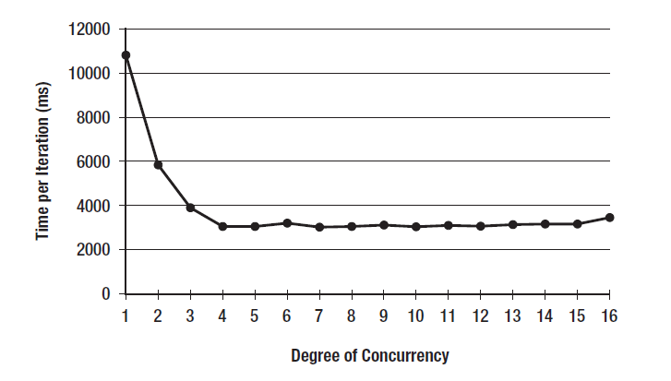

Slide 8
Availability - Framework 4

Slide 9
Some Functionality in 3.5
with Parallel Extensions CTP

Slide 10
Task Parallel Library (TPL) and Concurrency and Coordination Runtime (CCR)
Parallel LINQ (PLINQ)
New debugging and profiling tools
Coordination data structures
Parallel Pattern Library(PPL) C++ only

Slide 11
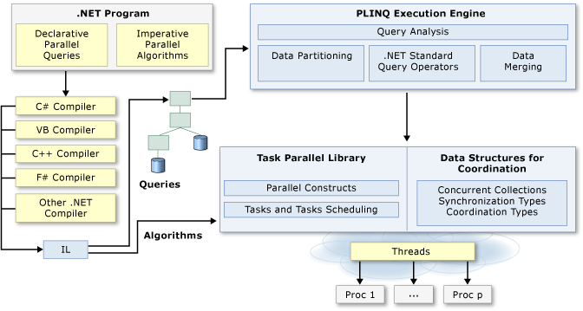

Slide 12
Some of the issues

Slide 13
Some of the issues
Race conditions
Notes:
Race conditions arise in software when separate processes or threads of execution depend on some shared state

Slide 14
Some of the issues
Race conditions
Deadlocks
Notes:
A deadlock is a situation in which two or more competing actions are waiting for the other to finish, and thus neither ever does

Slide 15
Some of the issues
Race conditions
Deadlocks
Thread starvation
Notes:
Thread starvation can be caused by creating too many threads

Slide 16
Some of the issues
Race conditions
Deadlocks
Thread starvation
Difficult to code and debug

Slide 17
Some of the issues
Race conditions
Deadlocks
Thread starvation
Difficult to code and debug
Environmental
Notes:
Optimizing code for different machine environments

Slide 18
Crap Code Running in Parallel is Just Parallelized Crap Code

Slide 19
Important Concepts

Slide 20
Concurrent != Parallel

Slide 21
Single Core Machine?

Slide 22
Parallelization Features
Can Slow Down

Slide 23
Getting Started?

Slide 24
Parallel.For()

Slide 25
Parallel.ForEach()

Slide 26
Task Factory
Notes:
So how does the task scheduler work?
1. When tasks are created, they are added to a global task queue.
2. The thread pool will create a number of “worker” threads. The exact number that are created
depends on a number of factors such as the number of cores on the machine, current work
load, type of work load, and so on. The thread pool utilizes a hill-climbing algorithm that
dynamically adjusts the thread pool to use the optimum number of threads. For example, if the
thread pool detects that many threads have an I/O bottleneck, it will create additional threads
to complete the work more quickly. The thread pool contains a background thread that checks
every 0.5 seconds to see whether any work has been completed. If no work has been done (and
there is more work to do), a new thread will be created to perform this work.
3. Each worker thread picks up tasks from the global queue and moves it onto its local queue for
execution.
4. Each worker thread processes the tasks on its queue.
5. If a thread finishes all the work in its local queue, it steals work from other queues to ensure that
work is processed as quickly as possible. Note that tasks will steal work from the end of the other
task’s queues to minimize the chance that the task has started operating with the work already.

Slide 27
Debugging Enhancements

Slide 28
Parallel Task Window

Slide 29
Parallel Stack Window

Slide 30
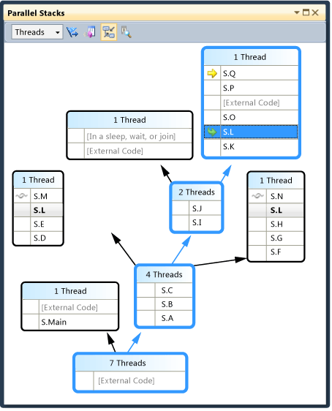

Slide 31
Avoid
Console.WriteLine()

Slide 32
Cancelling Task

Slide 33
Task Scheduler
Notes:
In the .NET Framework 4, this queue has been improved to use a lock-free algorithm that resembles the ConcurrentQueue class. Using lock-free implementation ThreadPool spends less time when it queues and de-queues work items. This performance benefit is available to all programs that use the ThreadPool

Slide 34
Work Stealing
Notes:
The .NET Framework 4 ThreadPool also features a work-stealing algorithm to help make sure that no threads are sitting idle while others still have work in their queues.
Stealing work from other thread’s local queue tail.

Slide 35
PLINQ

Slide 36
Questions ?

Slide 37
Future Considerations

Slide 38
Dormant GPUs

Slide 39
Distribute work across
multiple machines?

Slide 40
Pricing/licensing
models reconsideration

Slide 41
Valdis Iljuconoks
Software Architect
Nexum Insurance Technologies
Microsoft MVP
valdis.iljuconoks@dotnet.lv
http://dotnet.lv/blogs/vi

Slide 42
www.dotnet.lv

